Slide 1


2026 Call For Mentors
The group mentoring initiative brings together Life Members with students on campus to impart real-world experiences
Call for IEEE Industry Mentors
Shape the Next Generation of Engineering & Technology Leaders
IEEE is launching a global Student Mentoring Program and invites industry professionals, senior experts, and leaders to become mentors and help bridge the critical gap between academic knowledge and real-world professional skills.
This initiative goes beyond technical training. It focuses on the human, operational, and leadership capabilities that employers worldwide identify as essential — and often missing — in early-career professionals.

Slide 2

2026 Call For Mentors
Why Become an IEEE Industry Mentor?
As an IEEE Industry Mentor, you will:
Shape future professionals beyond textbooks and algorithms
Share real-world insights that only experience provides
Strengthen the global engineering and technology ecosystem
Give back to IEEE while building your professional legacy
Inspire students across regions, cultures, and disciplines
Your experience can make the difference between a graduate and a job-ready professional.

Slide 3

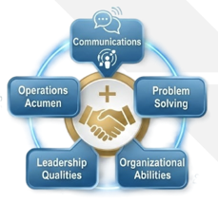
2026 Call For Mentors
Mentoring Focus Areas
Mentors will guide students in one or more of the following domains:
Communication Excellence
Active listening and constructive feedback
Professional writing and presentations
Non-verbal communication, empathy, and presence

Slide 4
2026 Call For Mentors
Problem-Solving & Critical Thinking (Global Priority)
Structured and innovative thinking
Troubleshooting and root-cause analysis
Brainstorming and decision-making under uncertainty
Organizational & Personal Effectiveness
Time and priority management
Goal setting, planning, and execution
Managing complexity and delivering results

Slide 5
2026 Call For Mentors
Leadership & Collaboration
Teamwork and inclusive leadership
Conflict resolution
Collaboration in multidisciplinary and multicultural teams
Operations & Industry Acumen
Finance fundamentals and business thinking, Business Skills
Product and project management
Standards, ethics, and professional responsibility

Slide 6

2026 Call For Mentors
Hands-On & Experiential Learning
Real-world case discussions
Practical projects and simulations
Industry-driven challenges and applied learning

Slide 7

2026 Call For Mentors
Who Should Apply?
We welcome:
IEEE Industry Members
Senior Members and Life Members
Professionals with experience in engineering, technology, management, or innovation
Experts willing to guide, listen, and inspire rather than lecture
No prior mentoring experience is required — IEEE will provide guidance and structure

Slide 8
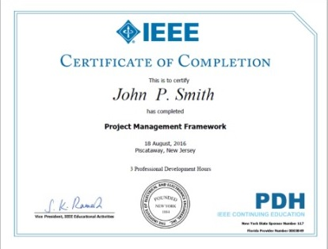
2026 Call For Mentors
Time Commitment
Flexible engagement: 2–4 hours per month
Program duration: 3–6 months
Format: Virtual or hybrid (depending on region)
Mentors may support individual students or small groups.
Mentor Recognition & Value
IEEE Industry Mentors will receive:
Official IEEE Mentoring Program recognition
Digital certificate and LinkedIn-ready badge
Visibility within IEEE communities and events
Priority consideration for future IEEE leadership and advisory roles

Slide 9

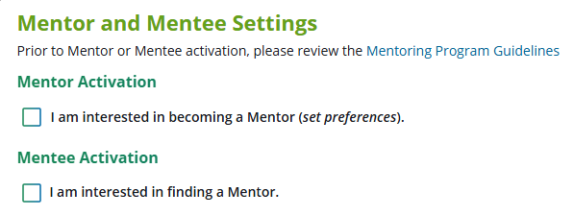
2026 Call For Mentors
Make an Impact That Scales Globally
By mentoring through IEEE, you contribute to:
Closing the global skills gap
Advancing ethical, inclusive, and sustainable innovation
Preparing professionals ready to lead in industry, academia, and society
Join Us as an IEEE Industry Mentor, Apply here
https://ieee-collabratec.ieee.org/app/career-services
Questions? Contact: Gustavo Giannattasio , LMC Subcommittee Mentoring Chair ggiannattasio@gmail.com
Your experience matters. Your mentorship multiplies it. Help us build professionals — not just graduates

Slide 10

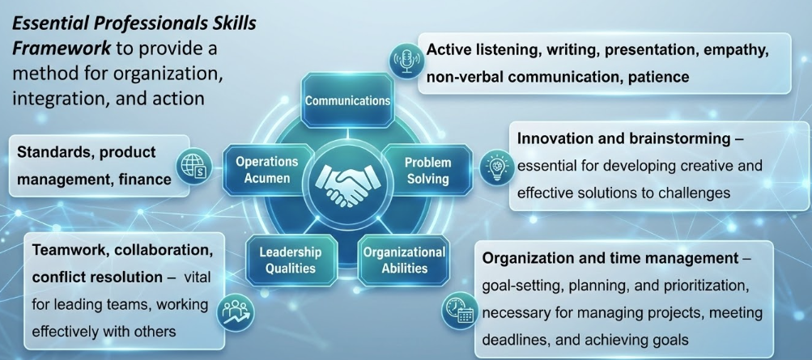
2026 Call For Mentors

